Slide 1
DS4023（2025 Fall） Machine Learning Department of Computer Science Beijing Normal-Hong Kong Baptist University

Slide 2
Chapter 6: Clustering

Slide 3
Outline
K-means
Hierarchical clustering
Distance measure
Normalized cuts
Spectral clustering

Slide 4
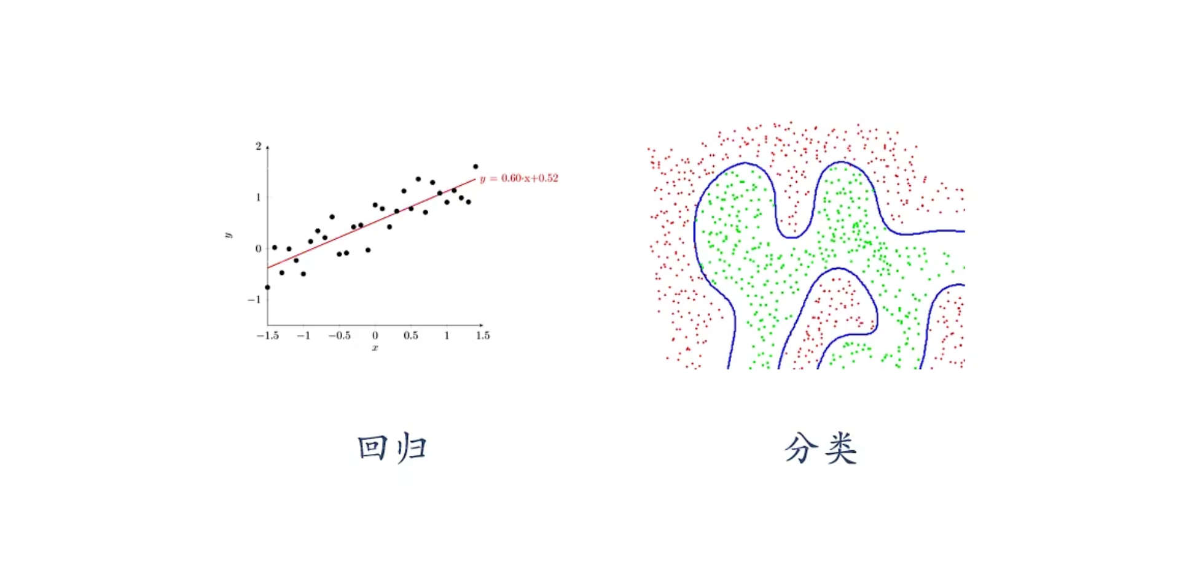
Typical Supervised Learning
Regression
Classification

Slide 5
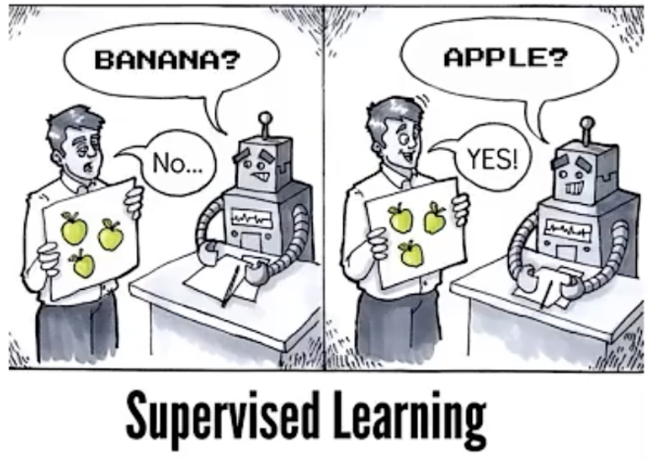

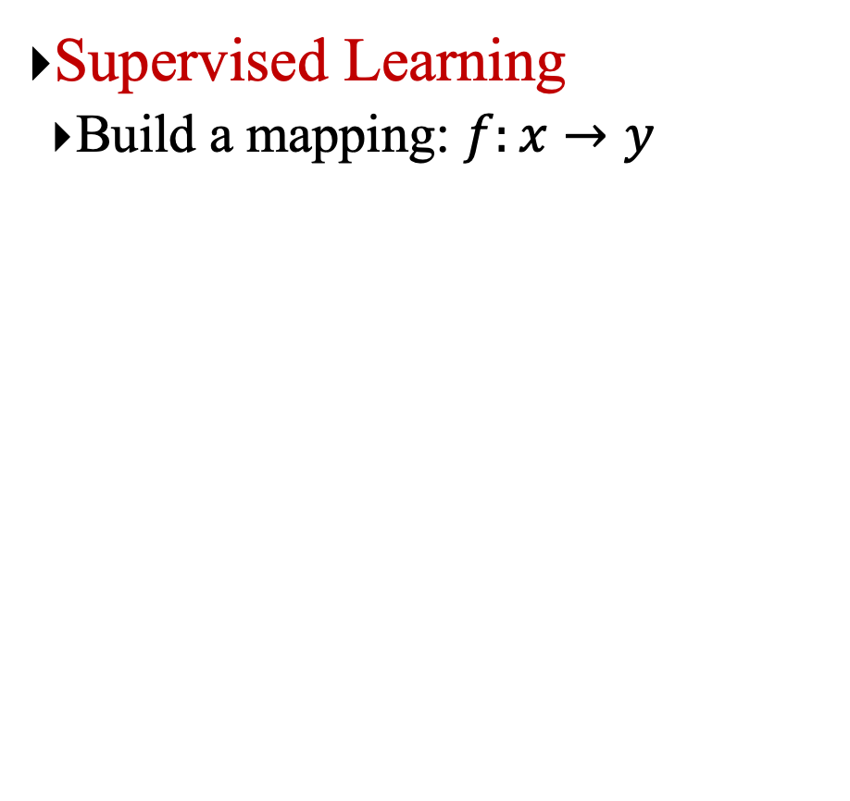
无监督学习（Unsupervised Learning）
Supervised Learning
Build a mapping: $f:x→y$
Unsupervised Learning
Learn some useful patterns from unlabeled data sets.

Slide 6
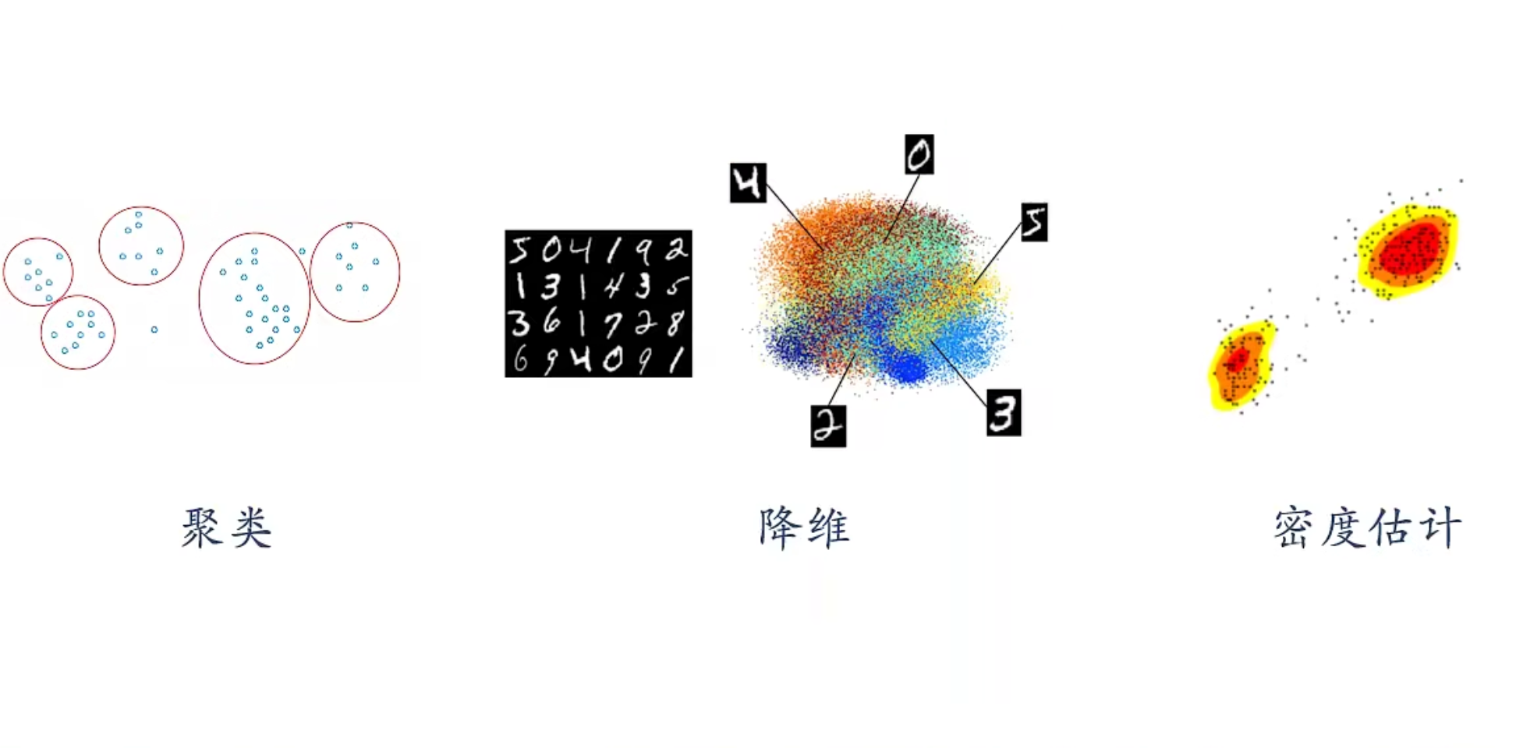
Typical Unsupervised Learning
Clustering
Dimension Reduction
Density Estimation

Slide 7
Supervised learning vs. unsupervised learning
Supervised learning: discover patterns in the data that relate data attributes with a target (class) attribute.
These patterns are then utilized to predict the values of the target attribute in future data instances.
Unsupervised learning: The data have no target attribute.
We want to explore the data to find some intrinsic structures in them.

Slide 8
Chapter 6.1: K-means Clustering

Slide 9
Clustering
Clustering is a technique for finding similarity groups in data, called clusters. I.e.,
It groups data instances that are similar to (near) each other in one cluster and data instances that are very different (far away) from each other into different clusters.
Clustering is often called an unsupervised learning task as no class values denoting an a priori grouping of the data instances are given, which is the case in supervised learning.
Due to historical reasons, clustering is often considered synonymous with unsupervised learning.
In fact, association rule mining is also unsupervised
This section focuses on clustering.

Slide 10
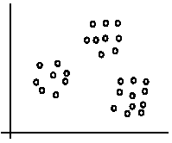
An illustration
The data set has three natural groups of data points, i.e., 3 natural clusters.

Slide 11
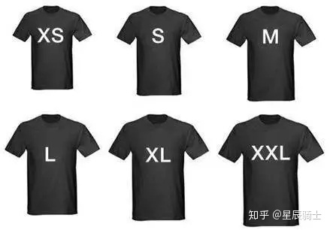

What is clustering for?
Let us see some real-life examples
Example 1: groups people of similar sizes together to make “small”, “medium” and “large” T-Shirts.
Tailor-made for each person: too expensive
One-size-fits-all: does not fit all.
Example 2: In marketing, segment customers according to their similarities
To do targeted marketing.

Slide 12
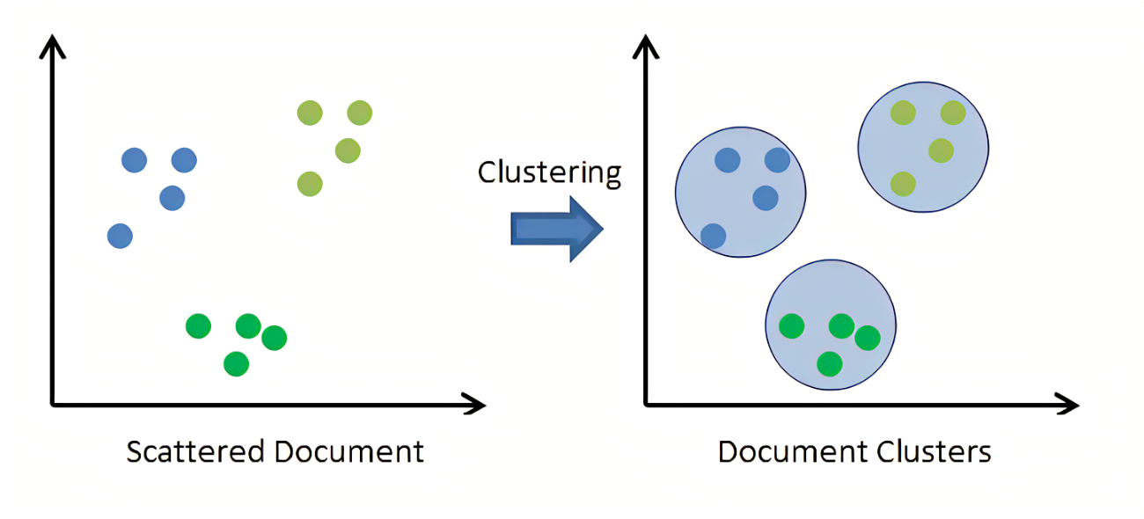
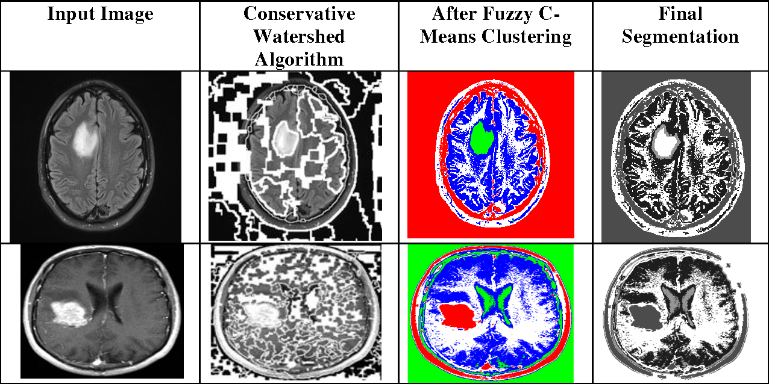
What is clustering for? (cont…)
Example 3: Given a collection of text documents, we want to organize them according to their content similarities,
To produce a topic hierarchy
In fact, clustering is one of the most utilized data mining and ML techniques.
It has a long history, and used in almost every field, e.g., medicine, psychology, botany, sociology, biology, archeology, marketing, insurance, libraries, etc.
In recent years, due to the rapid increase of online documents, text clustering becomes important.

Slide 13
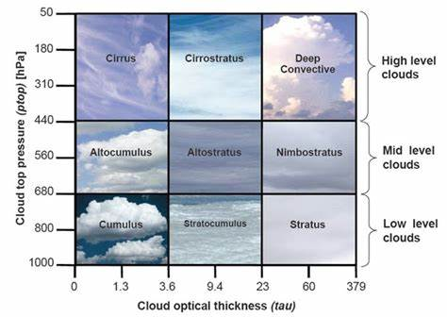

Cloud Clustering
Supervised or
Unsupervised Learning

Slide 14
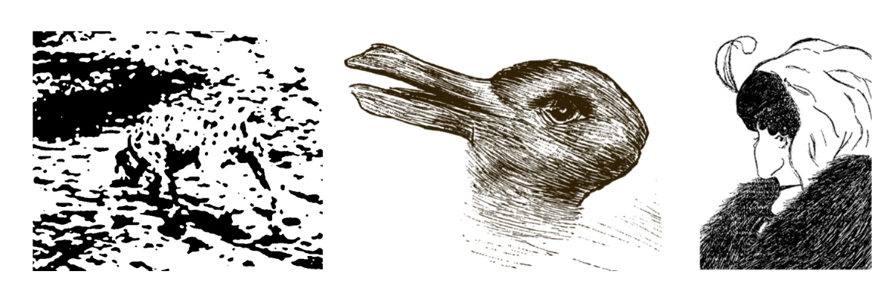
Automatic Clustering in Gestalt Psychology

Slide 15
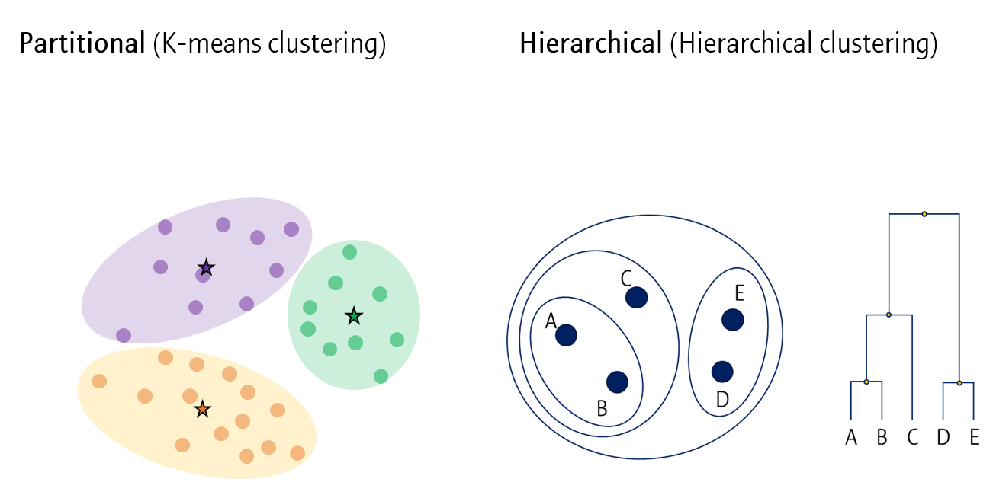
Aspects of clustering
A clustering algorithm
Partitional clustering
Hierarchical clustering
…
A distance (similarity, or dissimilarity) function
Clustering quality
Inter-clusters distance ⇒ maximized
Intra-clusters distance ⇒ minimized
The quality of a clustering result depends on the algorithm, the distance function, and the application.

Slide 16
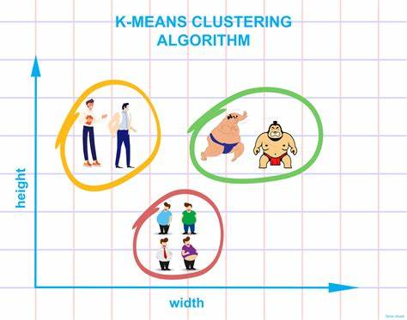
K-means clustering
K-means is a partitional clustering algorithm
Let the set of data points (or instances) D be
{x₁, x₂, …, x_{n}},
where x_{i} = (x_{i1}, x_{i2}, …, x_{ir}) is a vector in a real-valued space X ⊆ R^{r}, and r is the number of attributes (dimensions) in the data.
The k-means algorithm partitions the given data into k clusters.
Each cluster has a cluster center, called centroid.
k is specified by the user

Slide 17
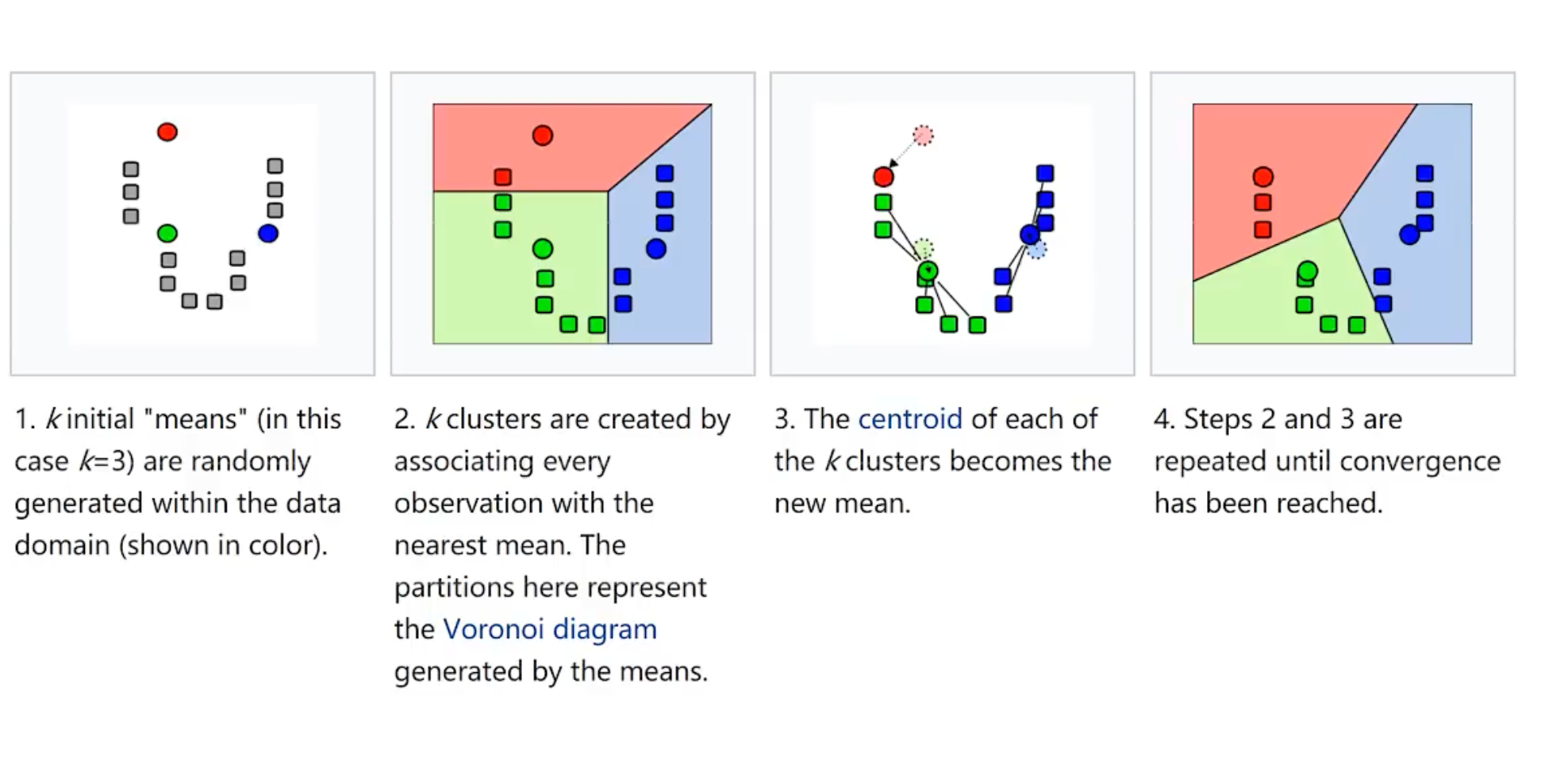
K-means algorithm

Slide 18
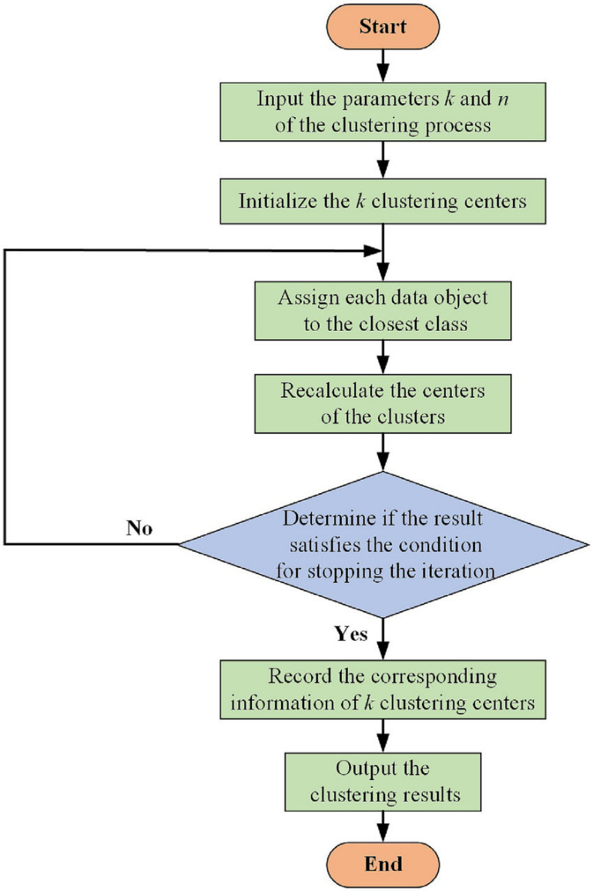
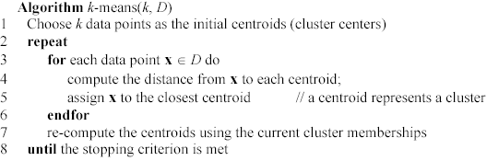
K-means algorithm (cont …)

Slide 19
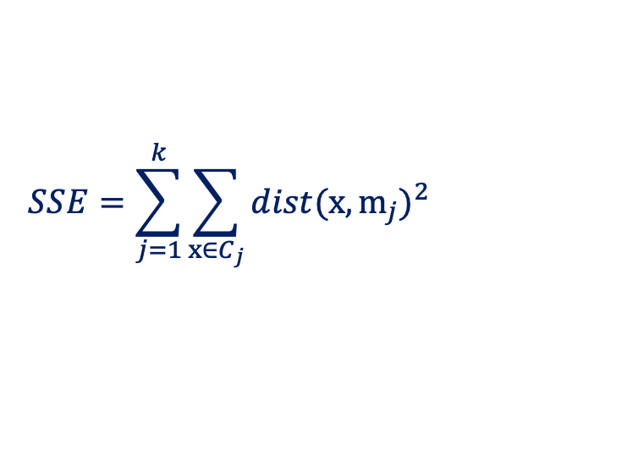
Stopping/convergence criterion
no (or minimum) re-assignments of data points to different clusters,
no (or minimum) change of centroids, or
minimum decrease in the sum of squared error (SSE),
C_{j} is the j-th cluster, m_{j} is the centroid of cluster C_{j} (the mean vector of all the data points in C_{j}), and dist(x, m_{j}) is the distance between data point x and centroid m_{j}.
$$SSE=\sum_{j=1}^{k}{\sum_{x∈C_{j}}{dist(x,m_{j})^{2}}}$$
(1)

Slide 20
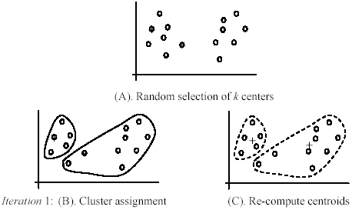
An example
+
+

Slide 21
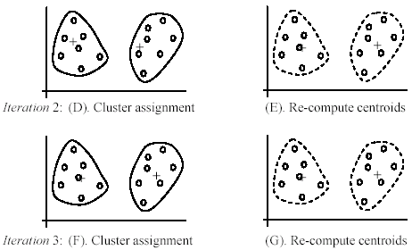
An example (cont …)

Slide 22
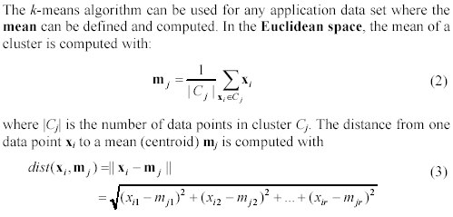
An example distance function

Slide 23
A disk version of k-means
K-means can be implemented with data on a disk
In each iteration, it scans the data once.
as the centroids can be computed incrementally
It can be used to cluster large datasets that do not fit in main memory
We need to control the number of iterations
In practice, a limit is set (< 50).
Not the best method. There are other scale-up algorithms, e.g., BIRCH.

Slide 24
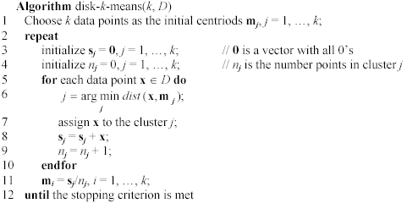
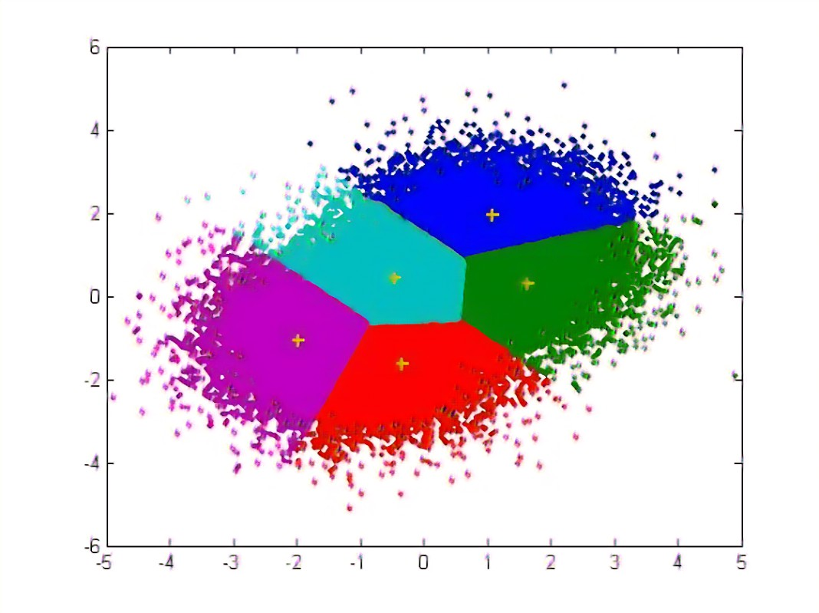
A disk version of k-means (cont …)

Slide 25
Strengths of k-means
Strengths:
Simple: easy to understand and to implement
Efficient: Time complexity: O(tkn),
where n is the number of data points,
k is the number of clusters, and
t is the number of iterations.
Since both k and t are small. k-means is considered a linear algorithm.
K-means is the most popular clustering algorithm.
Note that: it terminates at a local optimum if SSE (Sum of Square Error) is used. The global optimum is hard to find due to its complexity.

Slide 26
Weaknesses of k-means
The algorithm is only applicable if the mean is defined.
For categorical data, k-mode - the centroid is represented by most frequent values.
The user needs to specify k.
The algorithm is sensitive to outliers
Outliers are data points that are very far away from other data points.
Outliers could be errors in the data recording or some special data points with very different values.

Slide 27
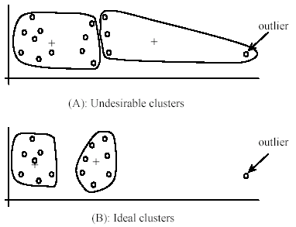
Weaknesses of k-means: Problems with outliers

Slide 28
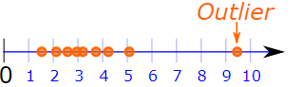
Weaknesses of k-means: To deal with outliers
One method is to remove some data points in the clustering process that are much further away from the centroids than other data points.
To be safe, we may want to monitor these possible outliers over a few iterations and then decide to remove them.
Another method is to perform random sampling. Since in sampling we only choose a small subset of the data points, the chance of selecting an outlier is very small.
Assign the rest of the data points to the clusters by distance or similarity comparison, or classification

Slide 29
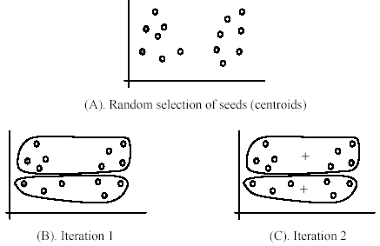
Weaknesses of k-means (cont …)
The algorithm is sensitive to initial seeds.

Slide 30
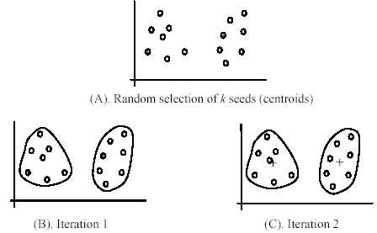
Weaknesses of k-means (cont …)
If we use different seeds: good results
There are some methods to help choose good seeds

Slide 31
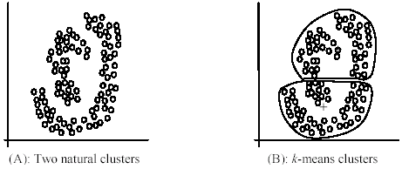
Weaknesses of k-means (cont …)
The k-means algorithm is not suitable for discovering clusters that are not hyper-ellipsoids (or hyper-spheres).
+

Slide 32
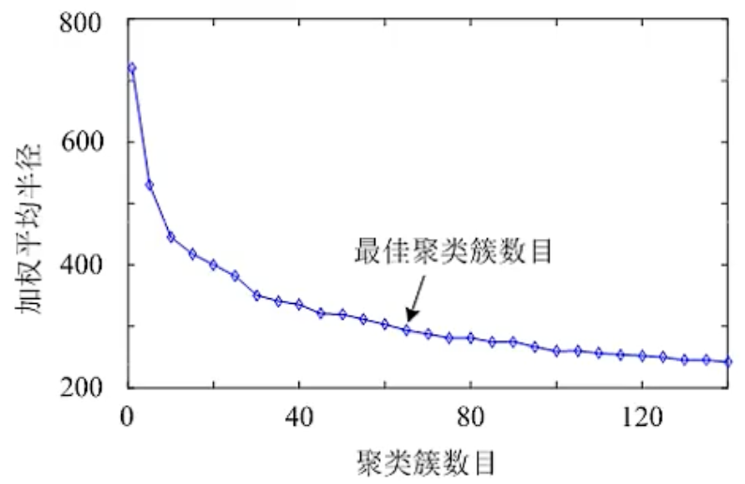
Hyperparameter Selection
K’s selection
Cluster center initialization
Random points/sample points larger than the minimum spacing
K sample points farthest from each other
K equidistant grid points

Slide 33
K-means summary
Despite weaknesses, k-means is still the most popular algorithm due to its simplicity and efficiency
Other clustering algorithms have their own lists of weaknesses.
No clear evidence that any other clustering algorithm performs better in general
Although they may be more suitable for some specific types of data or applications.
Comparing different clustering algorithms is a difficult task. No one knows the correct clusters!

Slide 34
Common ways to represent clusters
Use the centroid of each cluster to represent the cluster.
Compute the radius and standard deviation of the cluster to determine its spread in each dimension.
The centroid representation alone works well if the clusters are of hyper-spherical shape.
If clusters are elongated or are of other shapes, centroids are not sufficient.

Slide 35
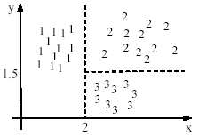
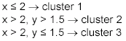
Using classification model
All the data points in a cluster are regarded to have the same class label, e.g., the cluster ID.
Run a supervised learning algorithm on the data to find a classification model.

Slide 36
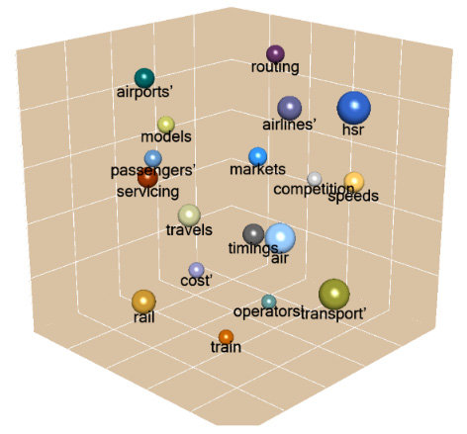
Use frequent values to represent cluster
This method is mainly for the clustering of categorical data (e.g., k-mode clustering).
The primary method used in text clustering is where a small set of frequent words in each cluster is selected to represent the cluster.

Slide 37
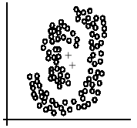
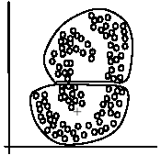
Clusters of arbitrary shapes
Hyper-elliptical and hyper-spherical clusters are usually easy to represent, using their centroid together with spreads.
Irregular shape clusters are hard to represent. They may not be useful in some applications.
Using centroids are not suitable (upper figure) in general
K-means clusters may be more useful (lower figure), e.g., for making 2 size T-shirts.

Slide 38
Chapter 6.2: Hierarchical Clustering

Slide 39
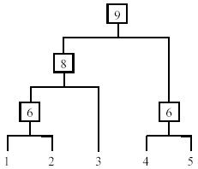
Hierarchical Clustering
Produce a nested sequence of clusters, a tree, also called Dendrogram.
Notes:
Dendrogram

Slide 40
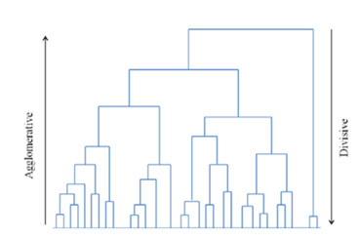
Types of hierarchical clustering
Agglomerative (bottom up) clustering: It builds the dendrogram (tree) from the bottom level, and
merges the most similar (or nearest) pair of clusters
stops when all the data points are merged into a single cluster (i.e., the root cluster).
Divisive (top down) clustering: It starts with all data points in one cluster, the root.
Splits the root into a set of child clusters. Each child cluster is recursively divided further
stops when only singleton clusters of individual data points remain, i.e., each cluster with only a single point

Slide 41
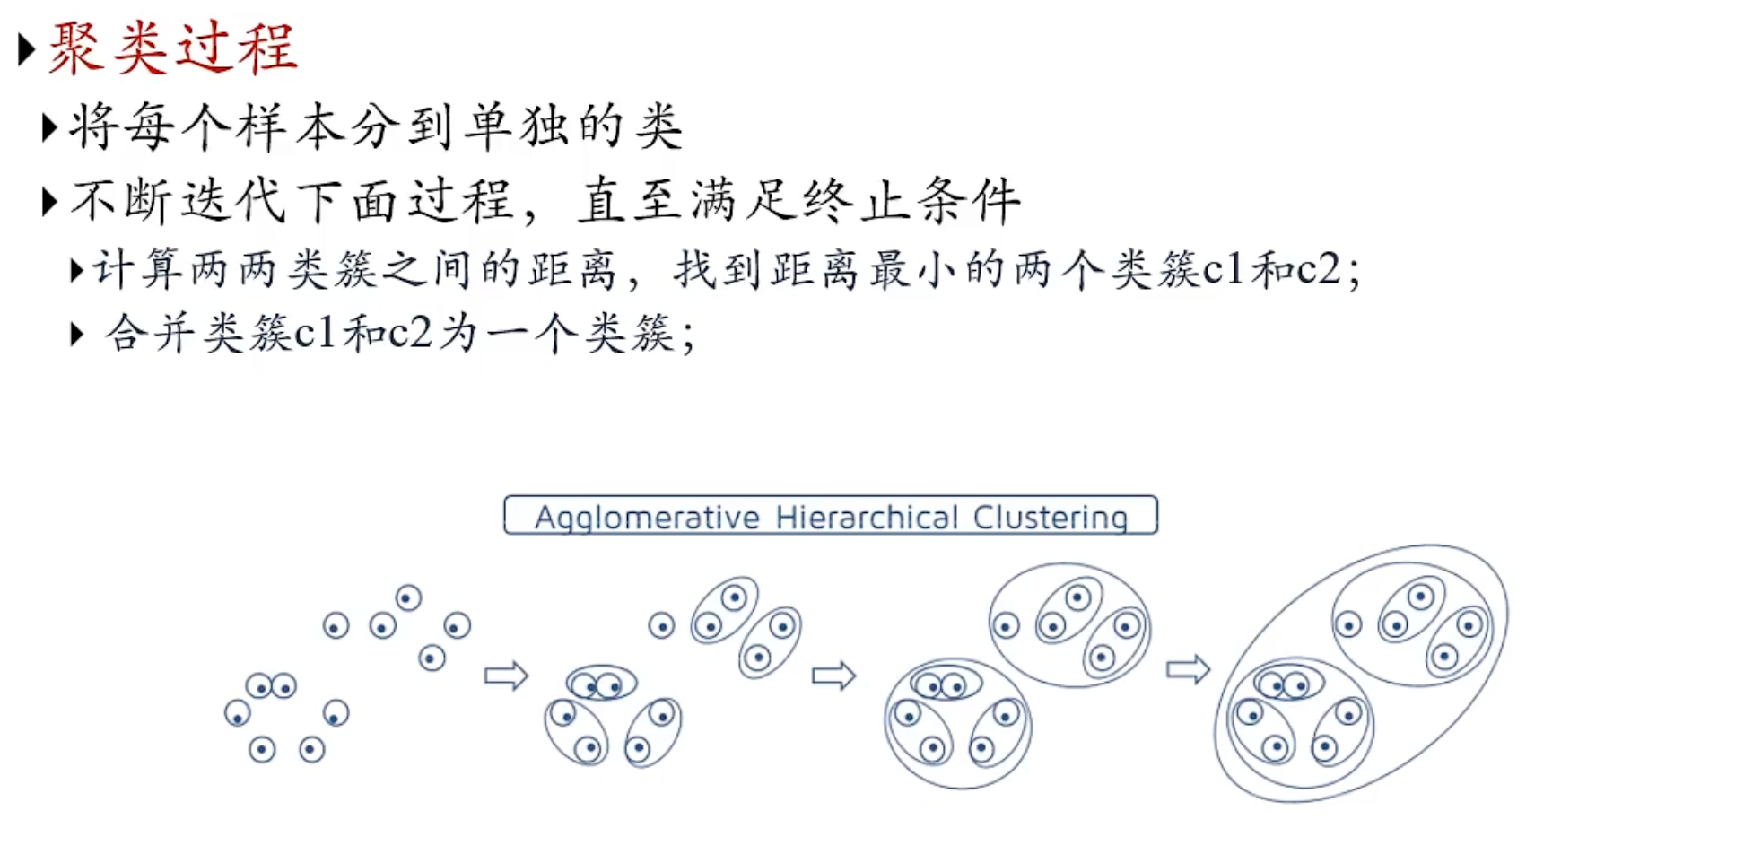
聚合（agglomerative）

Slide 42
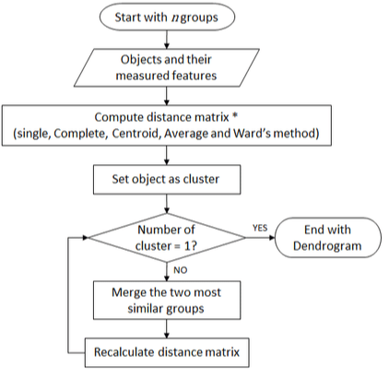
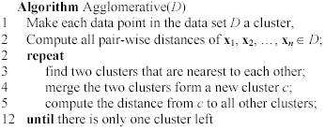
Agglomerative clustering algorithm

Slide 43
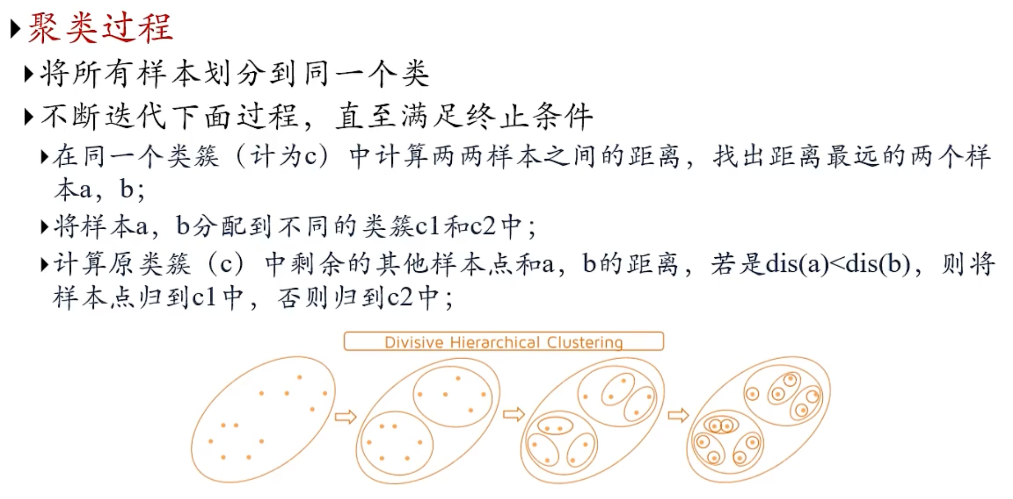
分裂（divisive）

Slide 44
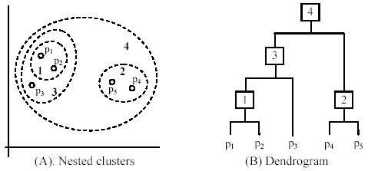
An example: working of the algorithm

Slide 45
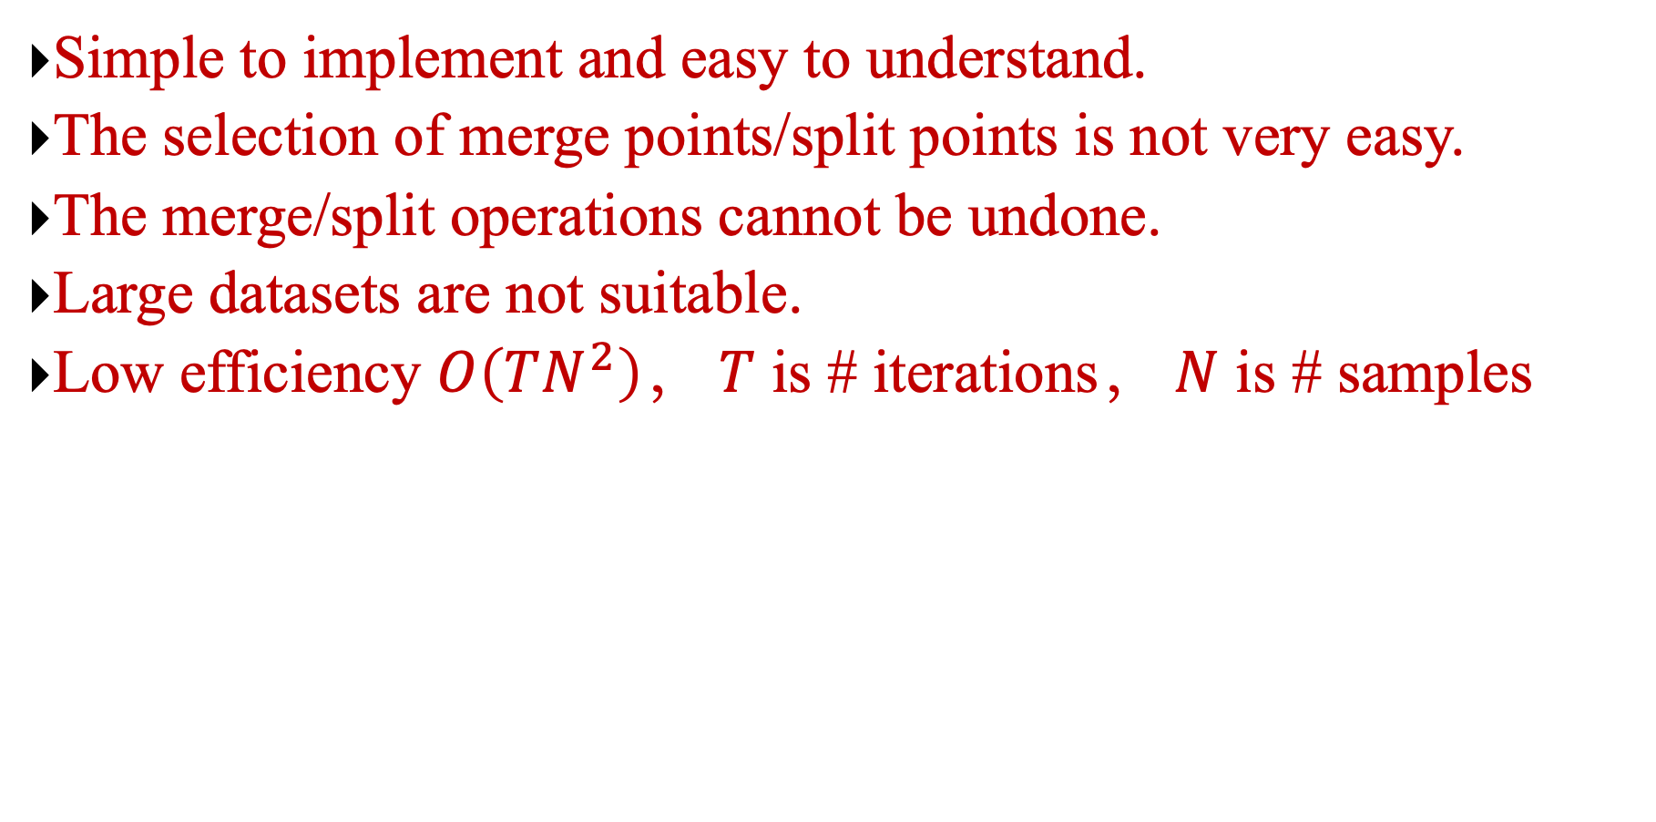
Advantages and Disadvantages
Simple to implement and easy to understand.
The selection of merge points/split points is not very easy.
The merge/split operations cannot be undone.
Large datasets are not suitable.
Low efficiency $O\left(TN^{2}\right)，$ $T$ is # iterations， $N$ is # samples

Slide 46
Chapter 6.3: Distance Measure

Slide 47
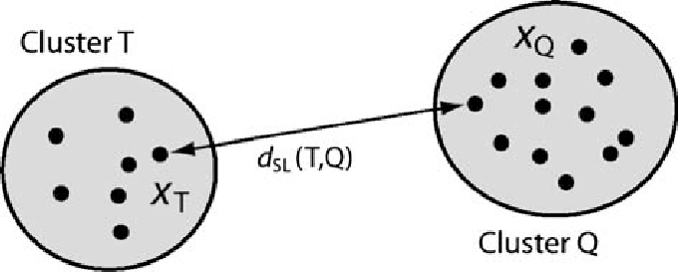
Measuring the distance of two clusters
A few ways to measure the distance of two clusters.
Results in different variations of the algorithm.
Single link
Complete link
Average link
Centroids
…

Slide 48
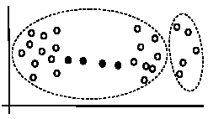
Single link method
The distance between two clusters is the distance between two closest data points in the two clusters, one data point from each cluster.
It can find arbitrarily shaped clusters, but
It may cause the undesirable “chain effect” by noisy points
Two natural clusters are split into two

Slide 49
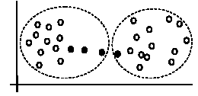
Complete link method
The distance between two clusters is the distance of two furthest data points in the two clusters.
It is sensitive to outliers because they are far away

Slide 50
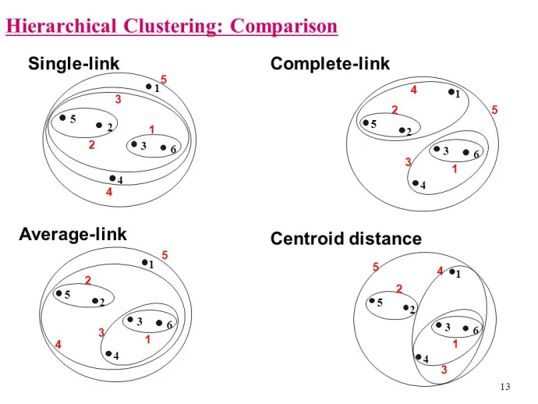

Average link and centroid methods
Average link: A compromise between
The sensitivity of complete-link clustering to outliers and the tendency of single-link clustering to form long chains that do not correspond to the intuitive notion of clusters as compact, spherical objects.
In this method, the distance between two clusters is the average distance of all pair-wise distances between the data points in two clusters.
Centroid method: In this method, the distance between two clusters is the distance between their centroids

Slide 51
The complexity
All the algorithms are at least O(n²). n is the number of data points.
Single link can be done in O(n²).
Complete and average links can be done in O(n²logn).
Due the complexity, hard to use for large data sets.
Sampling
Scale-up methods (e.g., BIRCH).

Slide 52
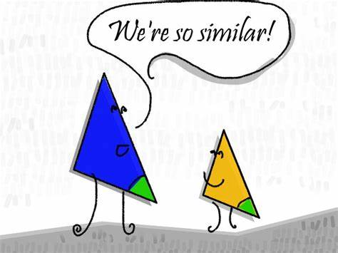
Distance functions
Key to clustering. “similarity” and “dissimilarity” can also commonly used terms.
There are numerous distance functions for
Different types of data
Numeric data
Nominal data
Different specific applications

Slide 53
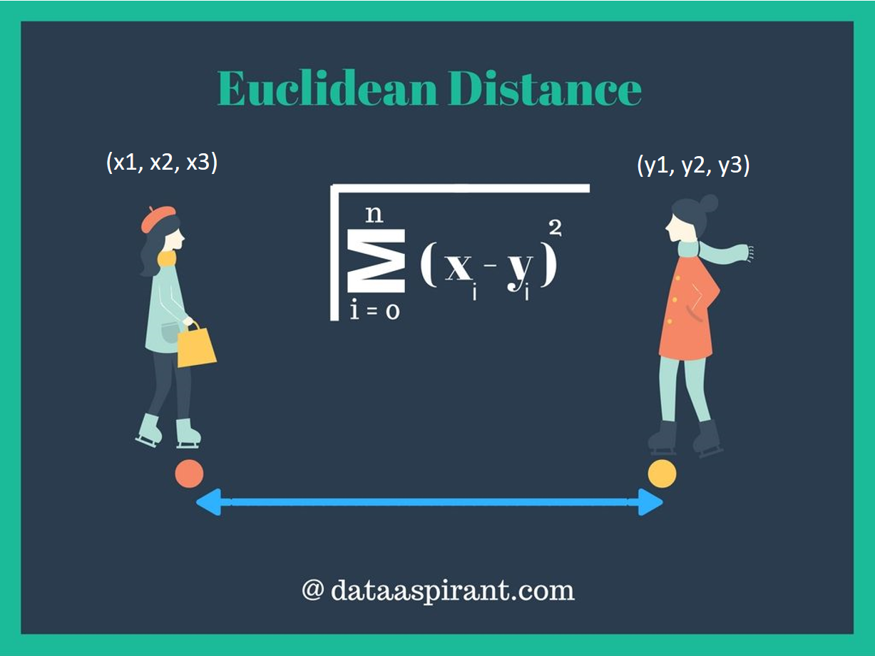
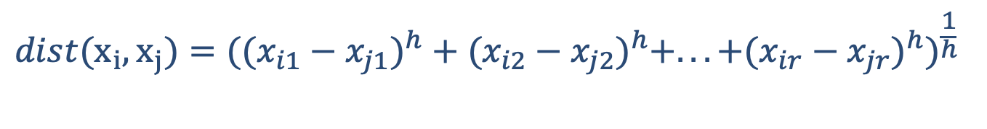
Distance functions for numeric attributes
Most commonly used functions are
Euclidean distance and
Manhattan (city block) distance
We denote distance with: dist(x_{i}, x_{j}), where x_{i} and x_{j} are data points (vectors)
They are special cases of Minkowski distance. h is positive integer.
$$dist(x_{i},x_{j})=((x_{i1}−x_{j1})^{h}+(x_{i2}−x_{j2})^{h}+...+(x_{ir}−x_{jr})^{h})^{\frac{1}{h}}$$

Slide 54
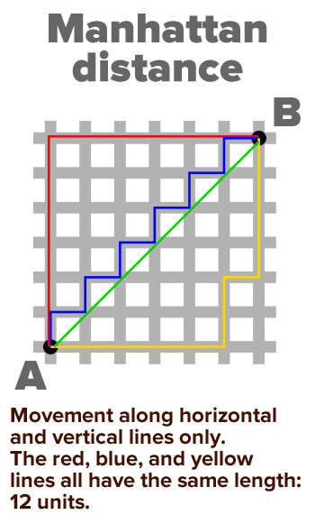
Euclidean distance and Manhattan distance
If h = 2, it is the Euclidean distance
If h = 1, it is the Manhattan distance
Weighted Euclidean distance
$$dist(x_{i},x_{j})=\sqrt{(x_{i1}−x_{j1})^{2}+(x_{i2}−x_{j2})^{2}+...+(x_{ir}−x_{jr})^{2}}$$
$$dist(x_{i},x_{j})=|x_{i1}−x_{j1}|+|x_{i2}−x_{j2}|+...+|x_{ir}−x_{jr}|$$
$$dist(x_{i},x_{j})=\sqrt{w_{1}(x_{i1}−x_{j1})^{2}+w_{2}(x_{i2}−x_{j2})^{2}+...+w_{r}(x_{ir}−x_{jr})^{2}}$$

Slide 55
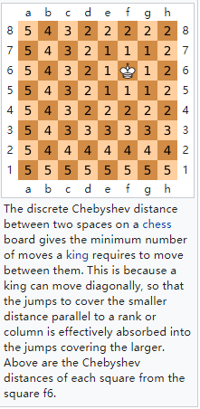
Squared distance and Chebychev distance
Squared Euclidean distance: to place progressively greater weight on data points that are further apart.
Chebychev distance: one wants to define two data points as "different" if they are different on any one of the attributes.
$$dist(x_{i},x_{j})=(x_{i1}−x_{j1})^{2}+(x_{i2}−x_{j2})^{2}+...+(x_{ir}−x_{jr})^{2}$$
$$dist(x_{i},x_{j})=\max{(}|x_{i1}−x_{j1}|, |x_{i2}−x_{j2}|, ..., |x_{ir}−x_{jr}|)$$

Slide 56
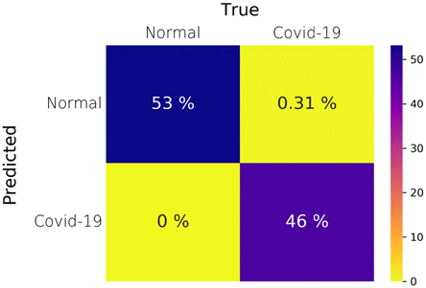
Distance functions for binary and nominal attributes
Binary attribute: has two values or states but no ordering relationships, e.g.,
Gender: male and female.
We use a confusion matrix to introduce the distance functions/measures.
Let the ith and jth data points be x_{i} and x_{j} (vectors)

Slide 57

Confusion matrix

Slide 58


Symmetric binary attributes
A binary attribute is symmetric if both of its states (0 and 1) have equal importance, and carry the same weights, e.g., male and female of the attribute Gender
Distance function: Simple Matching Coefficient, proportion of mismatches of their values
$$dist\left(x_{i},x_{j}\right)=\frac{b+c}{a+b+c+d}$$

Slide 59


Asymmetric binary attributes
Asymmetric: if one of the states is more important or more valuable than the other.
By convention, state 1 represents the more important state, which is typically the rare or infrequent state.
Jaccard coefficient is a popular measure
We can have some variations, adding weights
$$dist(x_{i},x_{j})=\frac{b+c}{a+b+c}$$

Slide 60

Nominal attributes
Nominal attributes: with more than two states or values.
the commonly used distance measure is also based on the simple matching method.
Given two data points x_{i} and x_{j}, let the number of attributes be r, and the number of values that match in x_{i} and x_{j} be q.

Slide 61

Distance function for text documents
A text document consists of a sequence of sentences and each sentence consists of a sequence of words.
To simplify: a document is usually considered a “bag” of words in document clustering.
Sequence and position of words are ignored.
A document is represented with a vector just like a normal data point.
It is common to use similarity to compare two documents rather than distance.
The most commonly used similarity function is the cosine similarity. We will study this later.

Slide 62
Data standardization
In the Euclidean space, standardization of attributes is recommended so that all attributes can have equal impact on the computation of distances.
Consider the following pair of data points
x_{i}: (0.1, 20) and x_{j}: (0.9, 720).
The distance is almost completely dominated by (720-20) = 700.
Standardize attributes: to force the attributes to have a common value range
$$dist(x_{i},x_{j})=\sqrt{(0.9−0.1)^{2}+(720−20)^{2}}=\text{700.000457,}$$

Slide 63

Interval-scaled attributes
Their values are real numbers following a linear scale.
The difference in Age between 10 and 20 is the same as that between 40 and 50.
The key idea is that intervals keep the same importance through out the scale
Two main approaches to standardize interval scaled attributes, range and z-score. f is an attribute
$$range(x_{if})=\frac{x_{if}−\min{(}f)}{\max{(}f)−\min{(}f)}$$

Slide 64



Interval-scaled attributes (cont …)
Z-score: transforms the attribute values so that they have a mean of zero and a mean absolute deviation of 1. The mean absolute deviation of attribute f, denoted by s_{f}, is computed as follows
$$s_{f}=\frac{1}{n}\left(|x_{1f}−m_{f}|+|x_{2f}−m_{f}|+...+|x_{nf}−m_{f}|\right),$$
$$m_{f}=\frac{1}{n}\left(x_{1f}+x_{2f}+...+x_{nf}\right),$$
Z-score:
$$z(x_{if})=\frac{x_{if}−m_{f}}{s_{f}}.$$

Slide 65


Ratio-scaled attributes
Numeric attributes, but unlike interval-scaled attributes, their scales are exponential,
For example, the total amount of microorganisms that evolve in a time t is approximately given by
Ae^{Bt},
where A and B are some positive constants.
Do log transform:
Then treat it as an interval-scaled attribuete
$$\log{(}x_{if})$$

Slide 66
Nominal attributes
Sometime, we need to transform nominal attributes to numeric attributes.
Transform nominal attributes to binary attributes.
The number of values of a nominal attribute is v.
Create v binary attributes to represent them.
If a data instance for the nominal attribute takes a particular value, the value of its binary attribute is set to 1, otherwise it is set to 0.
The resulting binary attributes can be used as numeric attributes, with two values, 0 and 1.

Slide 67

Nominal attributes: an example
Nominal attribute fruit: has three values,
Apple, Orange, and Pear
We create three binary attributes called, Apple, Orange, and Pear in the new data.
If a particular data instance in the original data has Apple as the value for fruit,
then in the transformed data, we set the value of the attribute Apple to 1, and
the values of attributes Orange and Pear to 0

Slide 68

Ordinal attributes
Ordinal attribute: an ordinal attribute is like a nominal attribute, but its values have a numerical ordering. E.g.,
Age attribute with values: Young, MiddleAge and Old. They are ordered.
Common approach to standardization: treat is as an interval-scaled attribute.

Slide 69
Mixed attributes
Our distance functions given are for data with all numeric attributes, or all nominal attributes, etc.
Practical data has different types:
Any subset of the 6 types of attributes,
interval-scaled,
symmetric binary,
asymmetric binary,
ratio-scaled,
ordinal
nominal

Slide 70

Convert to a single type
One common way of dealing with mixed attributes is to
Decide the dominant attribute type, and
Convert the other types to this type.
E.g, if most attributes in a data set are interval-scaled,
we convert ordinal attributes and ratio-scaled attributes to interval-scaled attributes.
It is also appropriate to treat symmetric binary attributes as interval-scaled attributes.

Slide 71
Convert to a single type (cont …)
It does not make much sense to convert a nominal attribute or an asymmetric binary attribute to an interval-scaled attribute,
but it is still frequently done in practice by assigning some numbers to them according to some hidden ordering, e.g., prices of the fruits
Alternatively, a nominal attribute can be converted to a set of (symmetric) binary attributes, which are then treated as numeric attributes.

Slide 72


Combining individual distances
This approach computes individual attribute distances and then combine them.
$$dist(x_{i},x_{j})=\frac{\sum_{f=1}^{r}{δ_{ij}^{f}}d_{ij}^{f}}{\sum_{f=1}^{r}{δ_{ij}^{f}}}$$

Slide 73

How to choose a clustering algorithm
Clustering research has a long history. A vast collection of algorithms are available.
We only introduced several main algorithms.
Choosing the “best” algorithm is a challenge.
Every algorithm has limitations and works well with certain data distributions.
It is very hard, if not impossible, to know what distribution the application data follow. The data may not fully follow any “ideal” structure or distribution required by the algorithms.
One also needs to decide how to standardize the data, to choose a suitable distance function and to select other parameter values.

Slide 74

Choose a clustering algorithm (cont …)
Due to these complexities, the common practice is to
run several algorithms using different distance functions and parameter settings, and
then carefully analyze and compare the results.
The interpretation of the results must be based on insight into the meaning of the original data together with knowledge of the algorithms used.
Clustering is highly application dependent and to certain extent subjective (personal preferences).

Slide 75

Cluster Evaluation: hard problem
The quality of a clustering is very hard to evaluate because
We do not know the correct clusters
Some methods are used:
User inspection
Study centroids, and spreads
Rules from a decision tree.
For text documents, one can read some documents in clusters.

Slide 76

Cluster evaluation: ground truth
We use some labeled data (for classification)
Assumption: Each class is a cluster.
After clustering, a confusion matrix is constructed. From the matrix, we compute various measurements, entropy, purity, precision, recall and F-score.
Let the classes in the data D be C = (c₁, c₂, …, c_{k}). The clustering method produces k clusters, which divides D into k disjoint subsets, D₁, D₂, …, D_{k}.

Slide 77

Evaluation measures: Entropy

Slide 78

Evaluation measures: purity

Slide 79


An example

Slide 80
A remark about ground truth evaluation
Commonly used to compare different clustering algorithms.
A real-life data set for clustering has no class labels.
Thus although an algorithm may perform very well on some labeled data sets, no guarantee that it will perform well on the actual application data at hand.
The fact that it performs well on some label data sets does give us some confidence of the quality of the algorithm.
This evaluation method is said to be based on external data or information.

Slide 81

Evaluation based on internal information
Intra-cluster cohesion (compactness):
Cohesion measures how near the data points in a cluster are to the cluster centroid.
Sum of squared error (SSE) is a commonly used measure.
Inter-cluster separation (isolation):
Separation means that different cluster centroids should be far away from one another.
In most applications, expert judgments are still the key.

Slide 82
Indirect evaluation
In some applications, clustering is not the primary task, but used to help perform another task.
We can use the performance on the primary task to compare clustering methods.
For instance, in an application, the primary task is to provide recommendations on book purchasing to online shoppers.
If we can cluster books according to their features, we might be able to provide better recommendations.
We can evaluate different clustering algorithms based on how well they help with the recommendation task.
Here, we assume that the recommendation can be reliably evaluated.

Slide 83
Chapter 6.4: Normalized cuts & Spectral clustering

Slide 84

Graph Partitioning
Undirected graph $G(V,E):$
Bi-partitioning task:
Divide vertices into two disjoint groups $A, B$
Questions:
How can we define a “good” partition of $G$?
How can we efficiently identify such a partition?
1
5
2
6
4
3
A
5
B
1
2
6
3
4

Slide 85
Graph Partitioning
What makes a good partition?
Maximize the number of within-group connections
Minimize the number of between-group connections
5
1
2
6
4
3
A
B

Slide 86

Graph Cut Criteria
Criterion: Normalized-cut [Shi-Malik, ’97]
Connectivity between groups relative to the density of each group
cut(A,B): total weight of edges between set A and set B
$vol(A)$: total weight of the edges with at least one endpoint in $A$: $vol\left(A\right)=\sum_{i∈A}{k_{i}}$
Why use this criterion?
Provides a more balanced approach to clustering compared to traditional methods.
Reduces the bias towards larger clusters.
How do we efficiently find a good partition?
Problem: Computing optimal cut is NP-hard

Slide 87


Spectral Graph Partitioning
A: adjacency matrix of undirected G
A_{ij} =1 if $(i,j)$ is an edge, else 0
x is a vector in ℜ^{n} with components $(x1,…, xn)$
Think of it as a label/value of each node of $G$
What is the meaning of A⋅ x?
Entry y_{i} is a sum of labels x_{j} of neighbors of i
$$y_{i}=\sum_{j=1}^{n}{A_{ij}}x_{j}=\sum_{\left(i,j\right)∈E}{x_{j}}$$

Slide 88


What is the meaning of Ax?
j^{th} coordinate of A⋅ x :
Sum of the x-values of neighbors of j
Make this a new value at node j
Spectral Graph Theory:
Analyze the “spectrum” of matrix representing $G$
Spectrum: Eigenvectors $x_{i}$ of a graph, ordered by the magnitude (strength) of their corresponding eigenvalues $λ_{i}$:
$$A⋅x=λ⋅x$$

Slide 89
Spectral Clustering Algorithms
Three basic stages:
1) Pre-processing
Construct a matrix representation of the graph
2) Decomposition
Compute eigenvalues and eigenvectors of the matrix
Map each point to a lower-dimensional representation based on one or more eigenvectors
3) Grouping
Assign points to two or more clusters, based on the new representation

Slide 90

Spectral Partitioning Algorithm
1) Pre-processing:
Build Laplacian matrix L of the graph
Laplacian matrix $L=D−A$, where D is the
Degree matrix (a diagonal matrix where each entry represents the degree of a vertex) and A is the adjacency matrix.
 | 1 | 2 | 3 | 4 | 5 | 6
1 | 3 | -1 | -1 | 0 | -1 | 0
2 | -1 | 2 | -1 | 0 | 0 | 0
3 | -1 | -1 | 3 | -1 | 0 | 0
4 | 0 | 0 | -1 | 3 | -1 | -1
5 | -1 | 0 | 0 | -1 | 3 | -1
6 | 0 | 0 | 0 | -1 | -1 | 2

Slide 91
Spectral Partitioning Algorithm
2) Decomposition:
Find eigenvalues λ and eigenvectors x of the matrix L
The eigenvalues and eigenvectors provide
insights into the structure of the graph.
Map vertices to corresponding components of λ₂
The smallest eigenvalue is always zero, and
the corresponding eigenvector is a constant vector. The second smallest eigenvalue (the Fiedler value) and its corresponding eigenvector are particularly important for partitioning.
0.0
0.4
0.3
-0.5
-0.2
-0.4
-0.5
1.0
0.4
0.6
0.4
-0.4
0.4
0.0
λ=
3.0
X =
0.4
0.3
0.1
0.6
-0.4
0.5
3.0
0.4
-0.3
0.1
0.6
0.4
-0.5
4.0
0.4
-0.3
-0.5
-0.2
0.4
0.5
5.0
0.4
-0.6
0.4
-0.4
-0.4
0.0
1
0.3
2
0.6
3
0.3
How do we now find the clusters?
4
-0.3
5
-0.3
6
-0.6

Slide 92
Spectral Partitioning
3) Grouping:
Sort components of reduced 1-dimensional vector
Identify clusters by splitting the sorted vector in two
How to choose a splitting point?
Naïve approaches:
Split at 0 or median value
More expensive approaches:
Attempt to minimize normalized cut in 1-dimension (sweep over ordering of nodes induced by the eigenvector)
1
0.3
Split at 0:
Cluster A: Positive points
Cluster B: Negative points
A
B
2
0.6
3
0.3
4
-0.3
1
0.3
4
-0.3
5
-0.3
2
0.6
5
-0.3
6
-0.6
3
0.3
6
-0.6

Slide 93

Spectral clustering: Pro and con
Pros
Generic framework, can be used with many different features and affinity formulations
Provides regular segments
Cons
Need to chose number of segments
High storage requirement and time complexity
Bias towards partitioning into equal segments
Usage
Image segmentation
Community detection in social networks
VLSI design
Data clustering in machine learning

